Slide 1

Pathology-MRI Registration For Improved Prostate MRI
University of Chicago: Department of Radiology
Joe Costello
NAZARAT HOSSAIN
Notes:
Intro: Joe
Comment 1: List the Title of our project
Comment 2: Stated alternatively, the virtual overlap of MRI & Pathology images enabling improved Prostate MRI
Comment 3: Partnering with UofC Hospital s Dept. of Radiology with strong support from various team members
Comment 4: My name is Joe Costello and my partner on the project is Nazarat Hossain

Slide 2
Problem & Research Purpose
Agenda
Data & Variable Definition
Methodology
Image Preparation
Findings
Conclusions & Recommendations

Slide 3
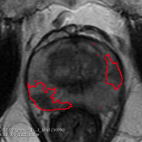
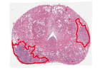
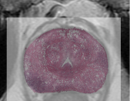
Registration Definition
Ensure high-level registration understanding to set the stage for the presentation
Image registration is defined as a process that overlays two or more images from various imaging equipment or sensors taken at different times and angles, or from the same scene to geometrically align the images for analysis
MRI (T2W)
Pathology
Registered MRI
& Pathology Image
Source: (Zitová and Flusser, 2003)
Source: Registration of pre-surgical MRI and whole-mount histopathology images in prostate cancer patients with radical prostatectomy (Rusu et al.) https://arxiv.org/pdf/1907.00324.pdf
Notes:
Joe
We are here based on the current state even though best in class MRI, there are challenges for experts reading of MRI Images
Challenges are caused by:
Image Format Point 1
Provider Imprecise Diagnosis
Leads to Suboptimal treatment plans that affects the patient’s quality of life

Slide 4




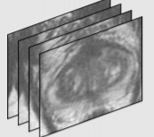
Multi-Parametric MRI Problem Definition
MRI imaging deficiencies can lead to suboptimal diagnosis & patient treatment options
Imaging Format
Provider
Patient
Historical Challenge
T2W prostate images shown
Requires radiologist assessment across MRI imaging formats
mpMRI (T2W, DCE, ADC etc.)
Low fidelity as compared to histology images
Physician expertise variation leads to:
Missed or imprecise prostate cancer diagnosis
Suboptimal patient treatment plans
Suboptimal treatments for patients can severely impact a patient’s quality of life.
Medical Image Niche Tools
Implementation challenges in practice
Source: Registration of pre-surgical MRI and whole-mount histopathology images in prostate cancer patients with radical prostatectomy (Rusu et al.) https://arxiv.org/pdf/1907.00324.pdf
4
Notes:
Joe
We are here based on the current state even though best in class MRI, there are challenges for experts reading of MRI Images
Challenges are caused by:
Image Format Point 1
Provider Imprecise Diagnosis
Leads to Suboptimal treatment plans that affects the patient’s quality of life

Slide 5
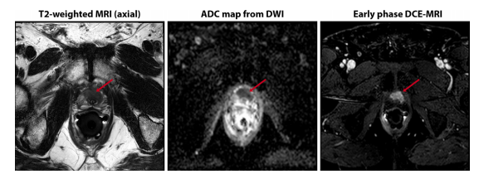
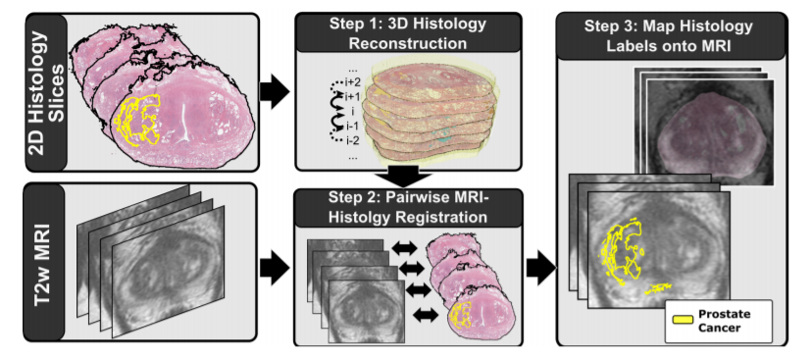
Pathology-MRI Registration Opportunity
Registration can enhance image quality, reduced expertise variation & lead to better outcomes
Current
Future
Deep radiological expertise required to properly diagnose prostate cancer across multi-parametric MRI formats
Map histology labels onto MRI provides increased visual acuity for radiologists
Source: Future Perspectives in Multiparametric Prostate MRI Imaging (Chatterjee & Oto)
Source: Registration of pre-surgical MRI and whole-mount histopathology images in prostate cancer patients with radical prostatectomy (Rusu et al.) https://arxiv.org/pdf/1907.00324.pdf
Notes:
Joe

Slide 6
Problem & Research Purpose
Agenda
Data & Variable Definition
Methodology
Image Preparation
Findings
Conclusions & Recommendations

Slide 7

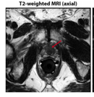
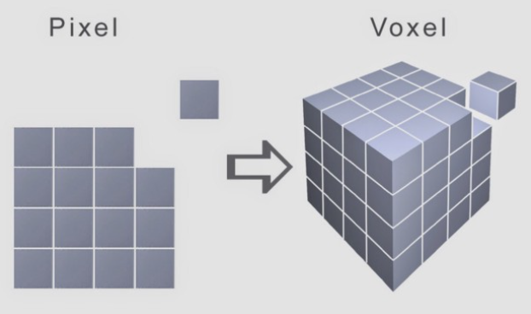
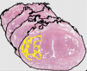
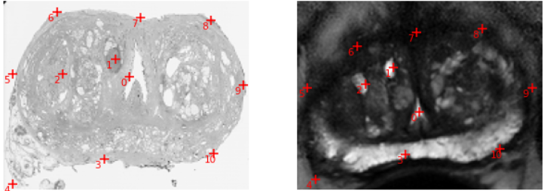
Data & Definition of Variables
Data Source & Registration Data Pipeline
Source
Fixed (Dependent Variable)
Registration Data Formats
Pixel x Pixel Grid (2D Slices)
Study Including ~140 patients
MRI
Format: T2W
Scanner: Olympus
Images per patient: ~24
Histology
excised prostate slices
~12 slices
Apex, Mid, Base
Moving (Independent Variable)
Fiducial Markers
Notes:
Joe

Slide 8
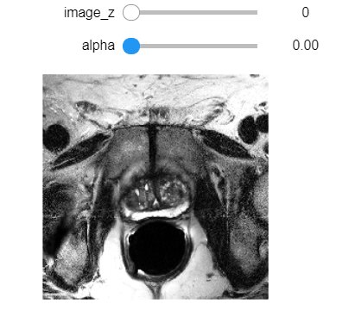
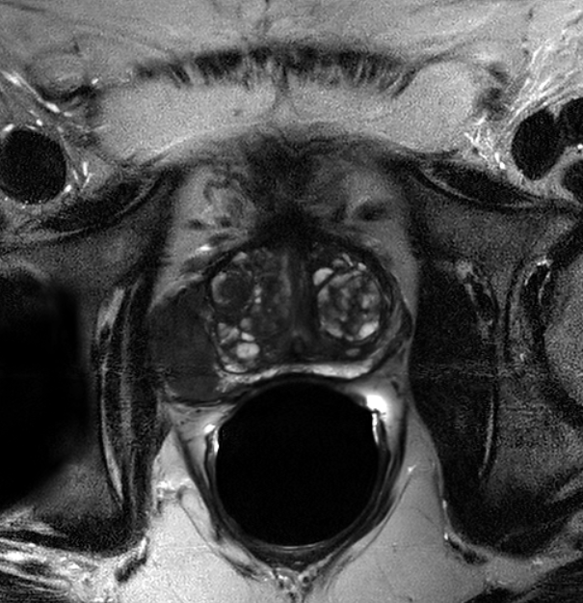
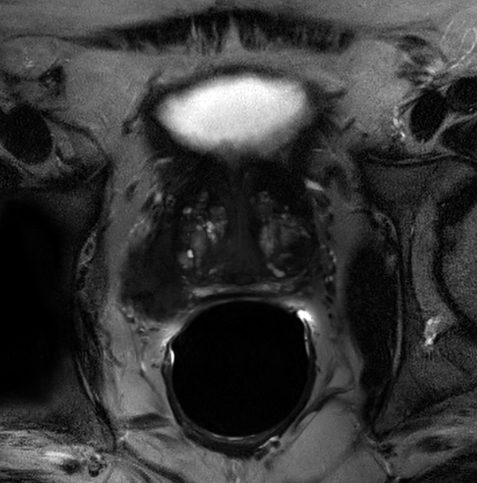
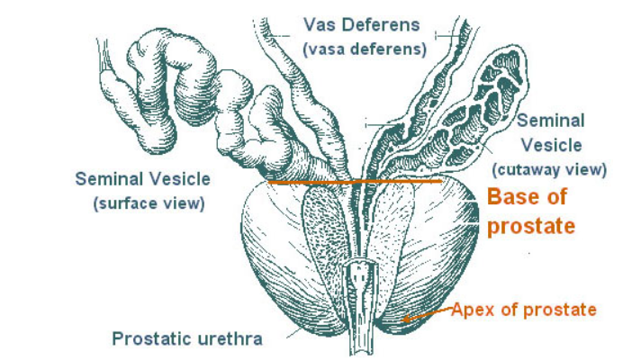
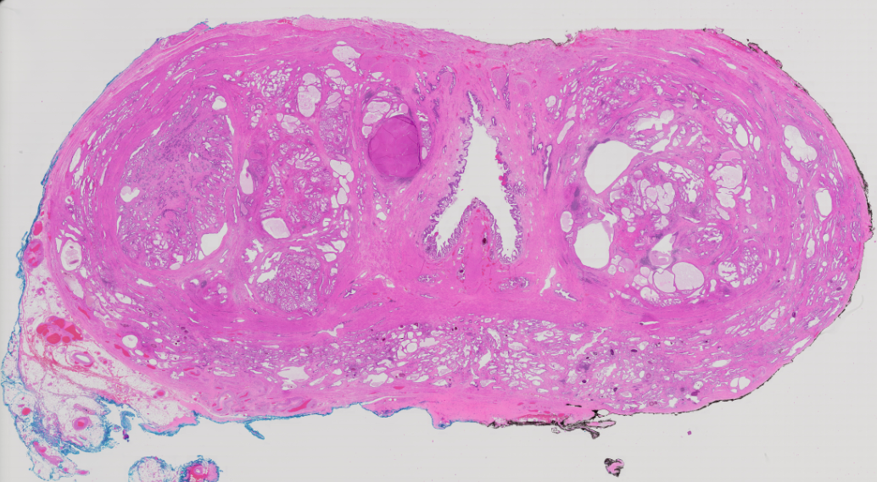
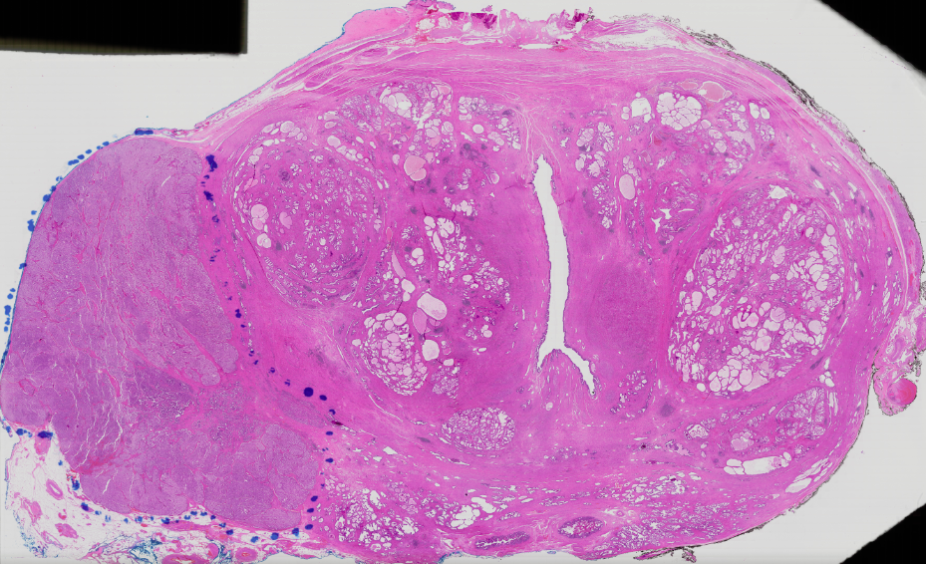
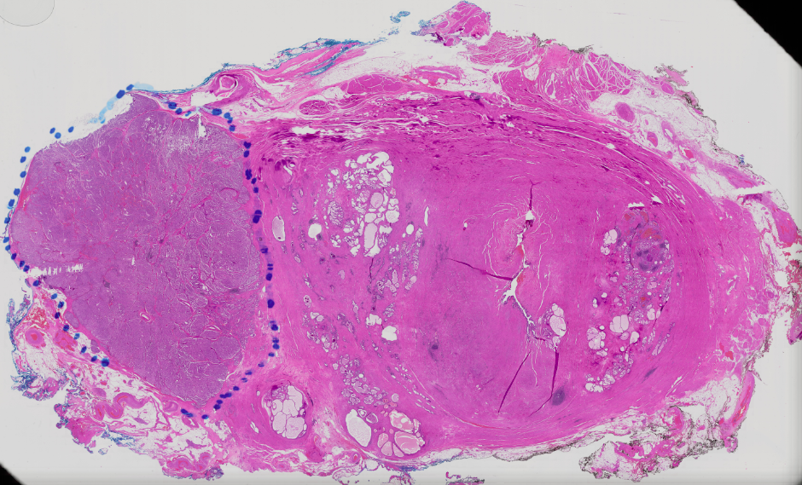
Data Sample & Additional Context
Registration of MRI & Histology Slices of 10 Prostate Cancer Patients at the targeted prostate positions (Apex, Mid & Base)
MRI (T2W)
Anatomical Graphic of the prostate regions
Apex
Mid
Base
Histology
Source: Anatomy of the Prostate | SEER Training (cancer.gov)
Notes:
Joe

Slide 9

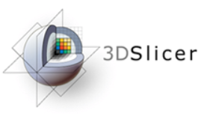
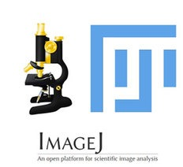
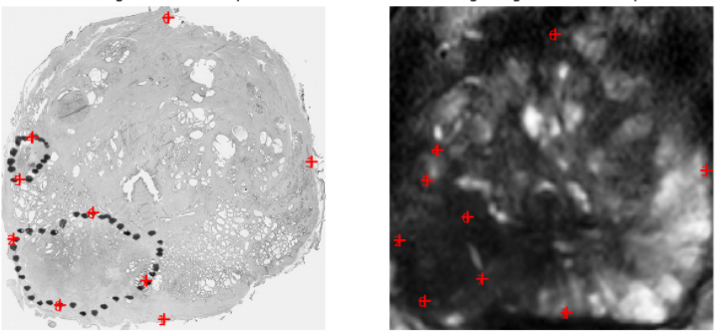
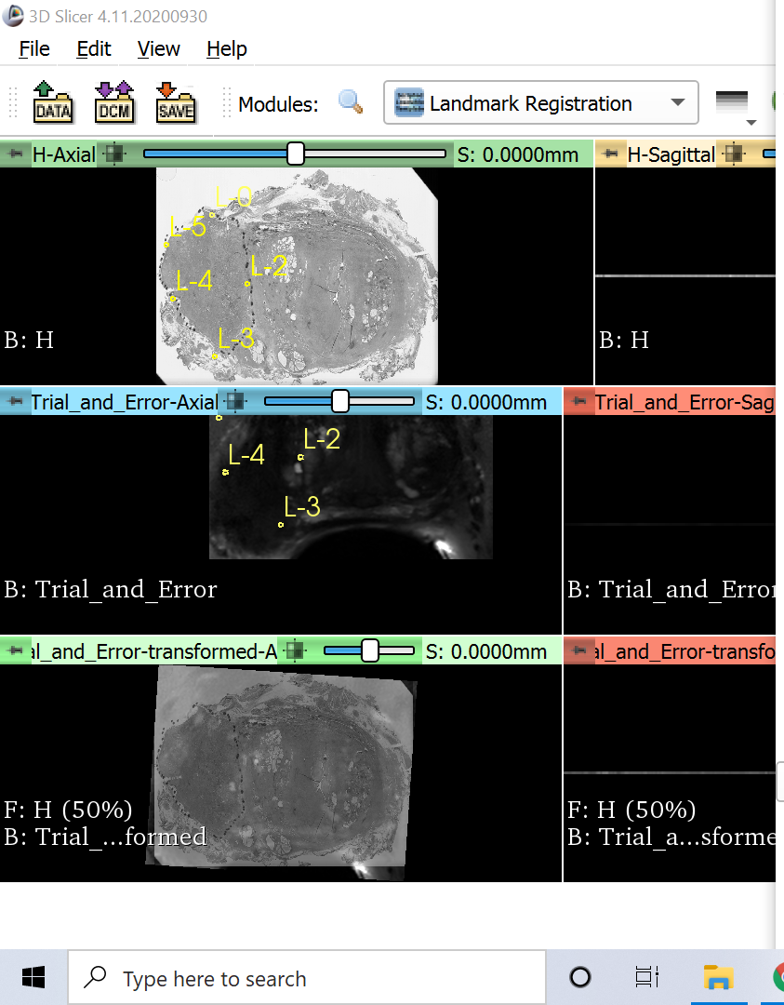
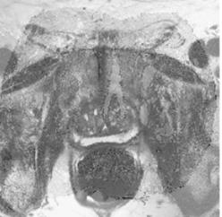
Registration Tools
Compared Registration Process & Performance with three primary tools
Fiji (ImageJ)
Many Steps required prior to registration & evaluation of results
Open-source multi-dimensional image analysis packages; enabled registration via Python scripts
Graphical User Interface to perform registration for comparison purposes
Built upon SITK packages
Fiji is an open source image processing package primarily leveraged for file format conversion & manual image segmentation
Source: https://simpleitk.org/
Source: 3D Slicer Welcome Tutorial (Sonia Pujol PhD)
Source: https://imagej.net/Fiji
9

Slide 10
Problem & Research Purpose
Agenda
Data & Variable Definition
Methodology
Image Preparation
Findings
Conclusions & Recommendations

Slide 11

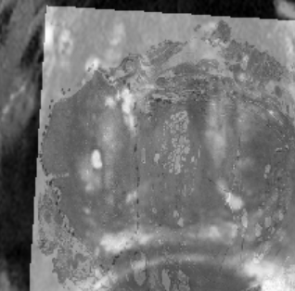
Registration Methodology
Data preparation & general framework leveraged across various tools
SimpleITK Image Registration Framework
Interpolator evaluates the intensity values of the moving image at the mapped position
Metric measures how well the transformed moving image fits the fixed image
Optimizer finds the set of parameters for the transform that results in the best possible value of an image metric
Transform measures the spatial mapping of points from the fixed image to the moving image space
Moving Image
Transform
Interpolator
Image Prep
Fixed Image
Metric
Optimizer
Virtual Image
Notes:
Nazarat
As a form of critical background, we wanted to set the stage with Registration General Framework
I will step through the process while also providing specific definitions where appropriate
Image Prep
Interpol

Slide 12
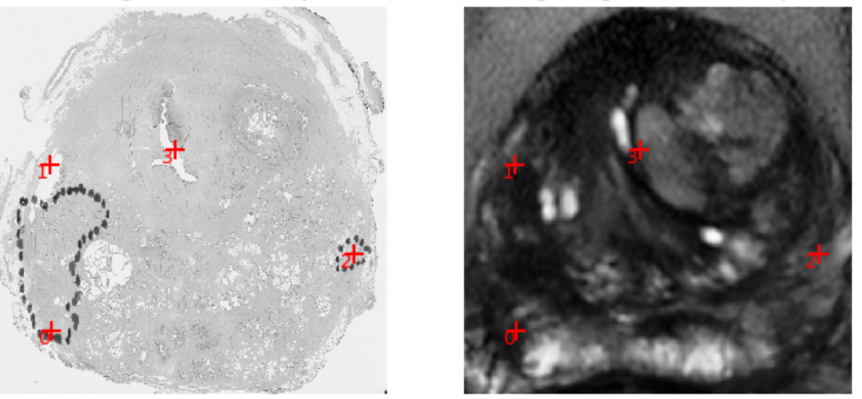
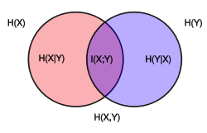
Registration Performance Evaluation
Mutual Information (MI) between images
Root Mean Square Deviance (RMSD) between fiducial markers
MI measures the amount of information that one random variable (image intensity) contains about another random variable (second image intensity)
The Higher the MI, the better the registration performance
Generally values range from 0; virtually no image intensity prediction
Value of 1; strong image intensity prediction
The RMSD measures the distance between the corresponding anatomical fiducial markers between the histopathology images and MRI in millimeters; the lower RMSD, the higher the registration performance
A
B
A
B
D
D
C
C
Source: https://matthew-brett.github.io/teaching/mutual_information.html
12
Notes:
Nazarat
https://matthew-brett.github.io/teaching/mutual_information.html
Evaluate performance and accuracy
Mutual Information
Root Mean Square Deviance

Slide 13
Problem & Research Purpose
Agenda
Data & Variable Definition
Methodology
Image Preparation
Findings
Conclusions & Recommendations

Slide 14
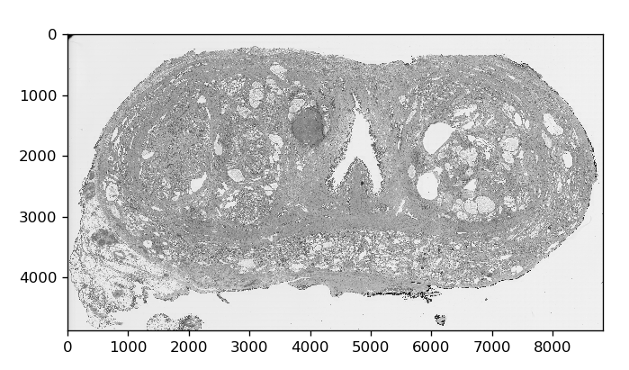
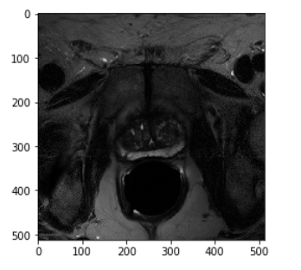
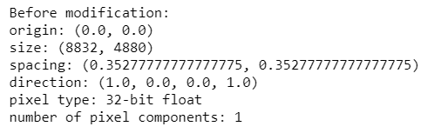
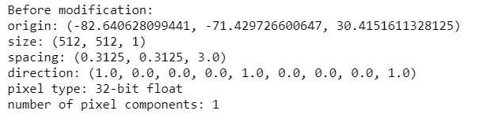
Image Preparation: Overall Process
Image preparation prior to registration is essential
Image Property Alignment
Image Segmentation & Scaling
Centering the images & Marking Fiducial Markers
Histology
MRI
Descriptive Statistics
Descriptive Statistics
Same origin across images
Same pixel size across images
Same spacing between pixels
Same dimensions across images (2D)
Notes:
Nazarat

Slide 15
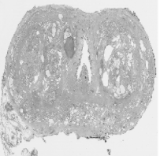
Image Preparation: Overall Process
Image preparation prior to registration is essential
Image Property Alignment
Image Segmentation and Scaling
Centering the Images & Marking Fiducial Markers
Segment prostate region from MRI
Scaling both MRI & Histology images ensuring the same pixel dimensions
512
512
512
512
Isolating the prostate in the pelvic cavity & ensuring image size alignment proved beneficial to registration
Notes:
Nazarat

Slide 16
Image Preparation: Overall Process
Image preparation prior to registration is essential
Image Property Alignment
Image Segmentation and Scaling
Centering the Images & Marking Fiducial Markers
Align the centers of the two images and set the center of rotation to the center of the fixed image.
Perform the image parameter initialization to set the window level for visualization
Similar fiducial markers marked across both image formats
Finally, perform the registration process across the two images
A
B
A
B
D
D
C
C
Notes:
Nazarat

Slide 17
Problem & Research Purpose
Agenda
Data & Variable Definition
Methodology
Image Preparation
Findings
Conclusions & Recommendations

Slide 18
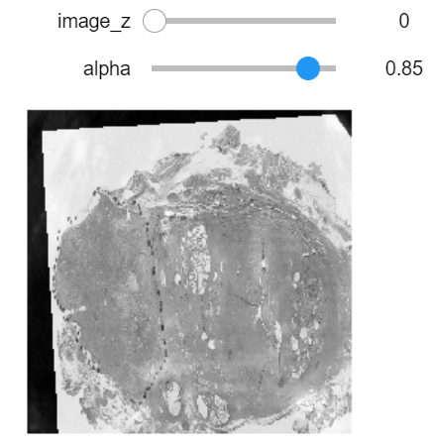
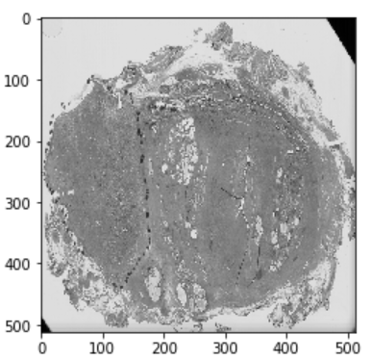
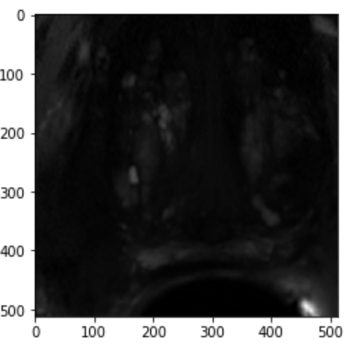
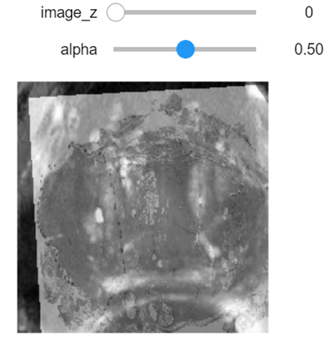
Registration Model Parameters Example
Parameter Tuning Increases registration performance
Moving histology image is rotated and translated
Transformed Histology Base
Moving Image
Transform: Euler2DTransform
Histology Base
Interpolator: sitkLinear
Similarity metric: Mutual Information
Number of histogram bins: 150
Sampling strategy: Random
Sampling percentage: 1%.
Optimizer: Gradient descent
Learning rate: 1.0
Number of iterations: 100
Convergence minimum value: 1e-6
Convergence window size: 10
Fixed Image
MRI Base
Virtual Image
Notes:
Nazarat

Slide 19
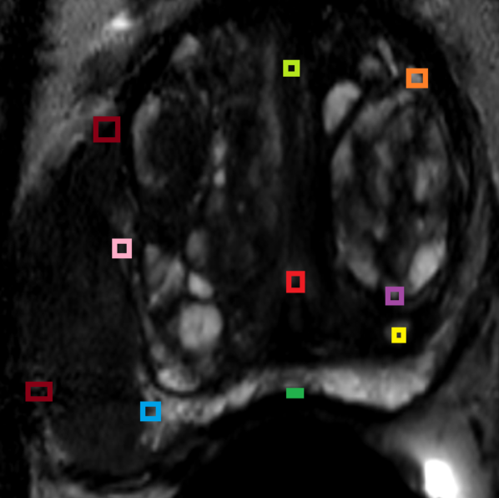
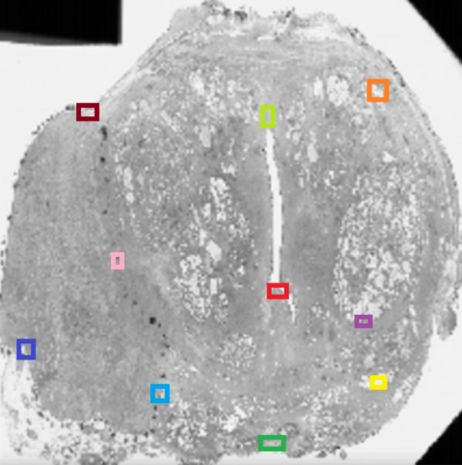
Initial Prostate Images Across Formats
Showing the initial images before registration
MRI Mid
Histology Mid
10 fiducial markers are marked by an expert across the images
19
Notes:
Nazarat

Slide 20
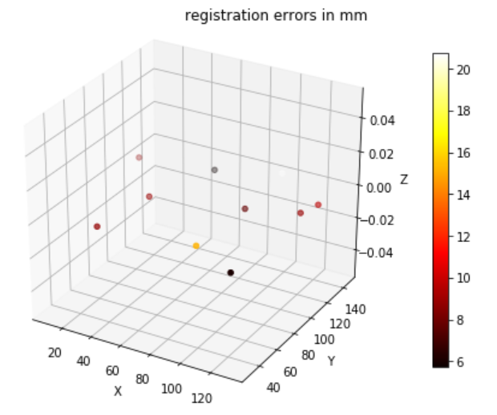
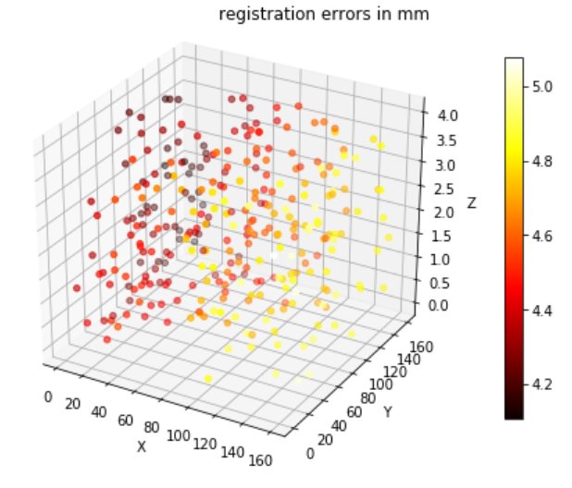
Visualizing the Registration Results
Increasing fiducial marker sample size reduces registration errors
Target Registration Error:
Target Registration Error after Tuning:
Generate a reference dataset from the reference transformation
(corresponding 300 points in the fixed and moving images).
* TRE = Target Registration Error (distance between fiducial markers)
20
Notes:
Nazarat

Slide 21
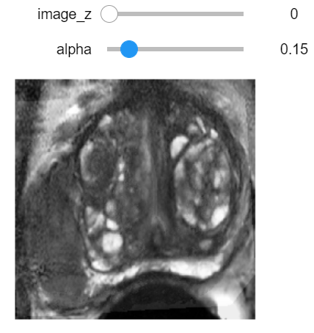
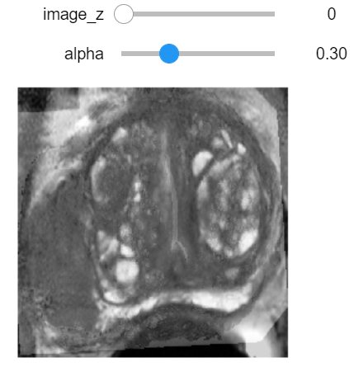
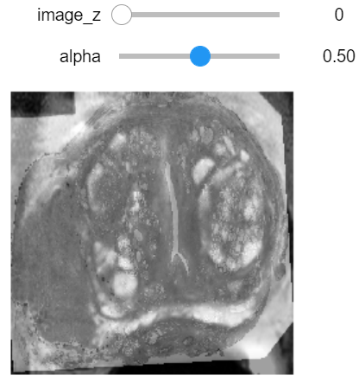
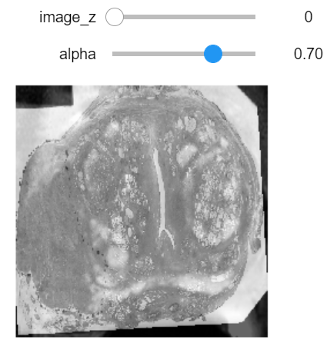
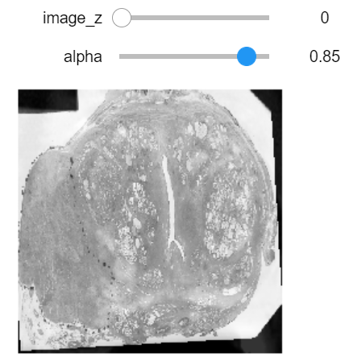
Registration Visualization Final Output
Registration process combines rigid image transformations in addition to the registration process
Visually evaluate the results after the final transform:
Results:
21
Notes:
Nazarat

Slide 22
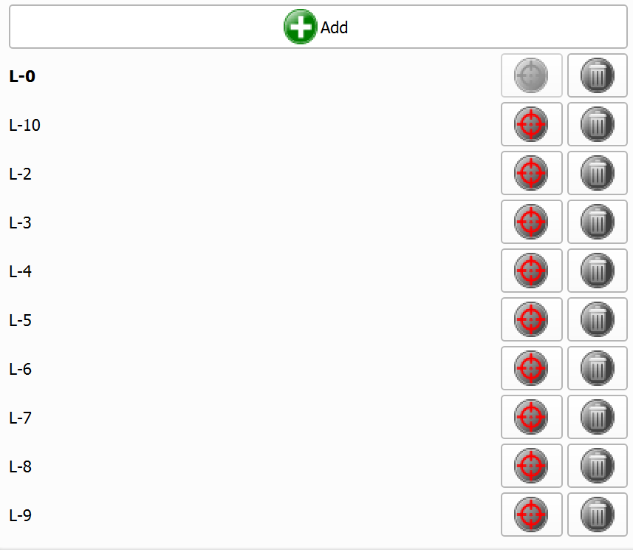
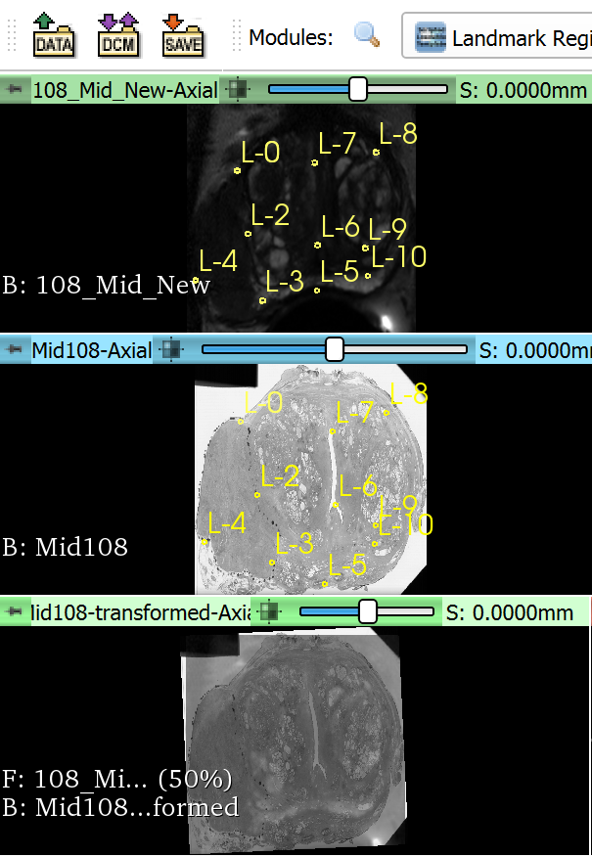
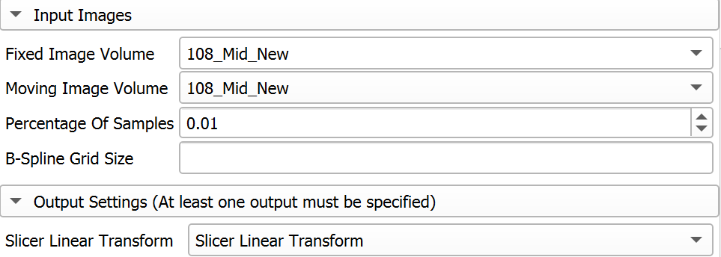
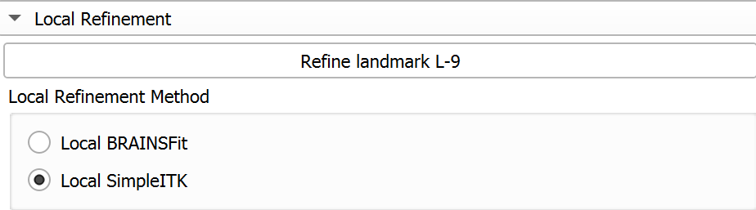
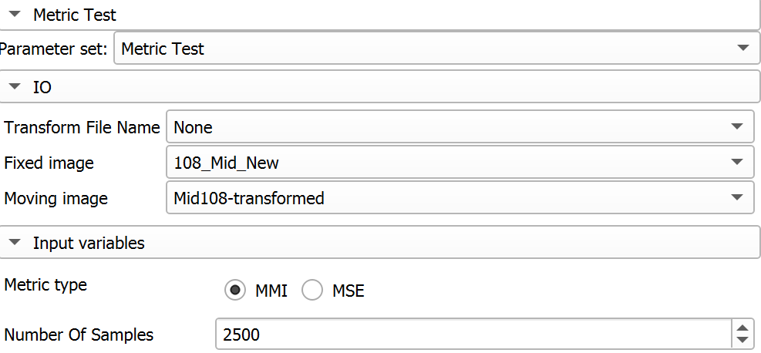
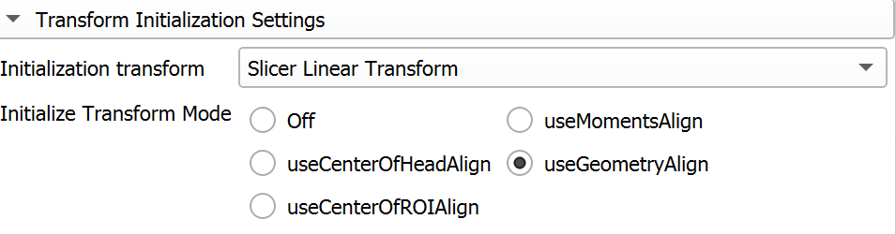
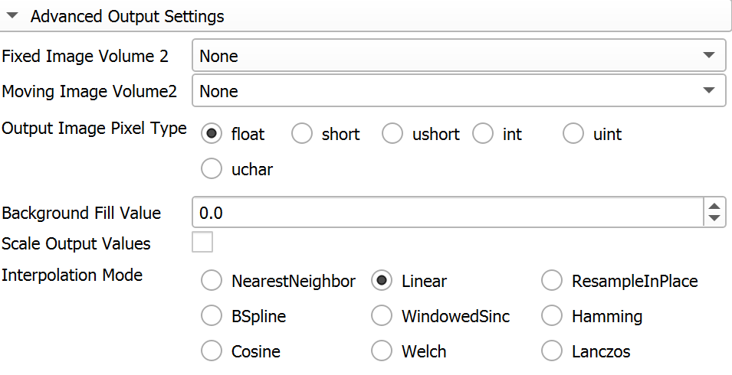

3D Slicer Registration Process & Performance
Comparison & Validation across tools
3D Slicer is a free and open source software package for image analysis and scientific visualization.
Mutual Information:
0.66 (SITK) > 0.52 (3D Slicer)
SimpleITK model performs better
22
Notes:
Nazarat

Slide 23

Registration Results Summary Per Patient Across Prostate Positions
Fiducial Marker error is decreasing across prostate positions & SITK outperforms 3D Slicer results
TRE Before Registration
~10.6 AVG MM ERROR
~0.51 AVG MI
~0.42 AVG MI
TRE After Registration
~0.12 STD DEV
~0.10 STD DEV
~7.5 AVG MM ERROR
~30% Error Reduction
* Please see supplemental slides for results across all 10 patients that we sampled in the study
23
Notes:
Joe

Slide 24
Problem & Research Purpose
Agenda
Data & Variable Definition
Methodology
Image Preparation
Findings
Conclusions & Recommendations

Slide 25
Conclusions & Recommendations
Conclusions
Recommendations
Strong promise for Pathology-MRI registration in a clinical setting
Deformation of the prostate images (ex. endorectal coil) will require non-rigid registration methods for improved registration performance
3D Slicer seemed more intuitive for image registration in a standard radiological process flow
Importance of data preparation
MRI image segmentation of the prostate instead of entire pelvic cavity
Image data format alignment for tools (ex. .tif)
Image scaling required due to vast pixel property variation across image formats
Parameter tuning of interpolators & optimizers important for improved registration performance
SITK had better registration performance, but due to enhanced user experience recommend 3D Slicer for future work:
Integrate more-closely with the consortium of medical institutions
Tool Subject Matter Experts to train imaging experts at UChicago Medicine
Qualitative inputs from radiologists to determine which model parameters augment image quality
Proposed proof of concept to embed image registration into radiology standard work flow
Recommend leveraging registered images into machine learning models to have enhanced training data sets
Notes:
Joe

Slide 26
Supplemental Slides

Slide 27
Registration Results Summary Per Patient Across Prostate Regions
Fiducial Marker error is decreasing across prostate zones & SITK outperforms 3D Slicer results
Patient | Position (MRI-Histology) | TRE in mm (Registration Error) | TRE in mm (Registration Error after tuning) | Mutual Information (SITK) | Mutual Information (3D Slicer)
Patient 101 | Apex | 10.67 (max: 30.18) | 7.93 (max: 13.56) | 0.56 | 0.50
 | Mid | 12.19 (max: 21.75) | 6.48(max: 10.06) | 0.42 | 0.37
 | Base | 9.77 (max: 16.48) | 5.75 (max: 9.14) | 0.54 | 0.40
Patient 108 | Apex | 10.95 (max: 19.96) | 6.32 (max: 6.92) | 0.58 | 0.53
 | Mid | 10.86 (max: 17.27) | 4.87 (max: 6.08) | 0.65 | 0.55
 | Base | 6.25 (max: 15.55) | 3.29 (max: 5.68) | 0.31 | 0.22
* Please see supplemental slides for results across all 10 patients that we sampled in the study
Notes:
Joe

Slide 28
Registration Results Summary Per Patient Across Prostate Regions
Fiducial Marker error is decreasing across prostate zones & SITK outperforms 3D Slicer results
Patient | Position (MRI-Histology) | TRE in mm (Registration Error) | TRE in mm (Registration Error after tuning) | Mutual Information | Mutual Information (3D Slicer)
Patient 101 | Apex | 10.67 (max: 30.18) | 7.93 (max: 13.56) | 0.56 | 0.50
 | Mid | 12.19 (max: 21.75) | 6.48(max: 10.06) | 0.42 | 0.37
 | Base | 9.77 (max: 16.48) | 5.75 (max: 9.14) | 0.54 | 0.40
Patient 102 | Apex | 13.23 (max: 23.38) | 9.85 (max: 10.64) | 0.57 | 0.51
 | Mid | 14.32 (max: 23.70) | 3.78 (max: 7.02) | 0.51 | 0.44
 | Base | 8.16(max: 15.04) | 6.96 (max: 11.39) | 0.20 | 0.20
Notes:
Joe

Slide 29
Registration Results Summary Per Patient Across Prostate Regions
Fiducial Marker error is decreasing across prostate zones & SITK outperforms 3D Slicer results
Patient | Position (MRI-Histology) | TRE in mm (Registration Error) | TRE in mm (Registration Error after tuning) | Mutual Information | Mutual Information (3D Slicer)
Patient 103 | Apex | 15.52 (max: 25.51 | 21.17 (max: 36.16) | 0.54 | 0.44
 | Mid | 7.95 (max: 12.27) | 5.19 (max: 5.79) | 0.41 | 0.35
 | Base | 5.44 (max: 10.37) | 2.96 (max: 3.07) | 0.29 | 0.26
Patient 105 | Apex | 10.02 ( max: 18.02) | 7.59 (max: 14.93) | 0.48 | 0.46
 | Mid | 10.52 (max: 14.60) | 3.40 (max: 6.46) | 0.51 | 0.45
 | Base | 10.39 (max: 18.57) | 5.42 (max: 9.91) | 0.44 | 0.39
Notes:
Joe

Slide 30
Registration Results Summary Per Patient Across Prostate Regions
Fiducial Marker error is decreasing across prostate zones & SITK outperforms 3D Slicer results
Patient | Position (MRI-Histology) | TRE in mm (Registration Error) | TRE in mm (Registration Error after tuning) | Mutual Information (Linear) | Mutual Information (3D Slicer) | Mutual Information (3D Slicer) (Non-Rigid*)
 | Apex | 3.31 (max: 6.45) | 2.33 (max: 4.28) | 0.78
Patient 106 | Mid | 4.43 (max: 11.38) | 3.56 (max: 4.36) | 0.71
 | Base | 4.34 (max: 8.61) | 3.56 (max: 4.56) | 0.48
Patient 107 | Apex | 4.28 (max: 5.29) | 3.07 (max: 4.99) | 0.58
 | Mid | 3.25 (max: 5.50) | 2.07 (max: 3.70) | 0.46
 | Base | 4.22 (max: 5.66) | 1.99 (max: 4.04) | 0.58
Notes:
Joe

Slide 31
Registration Results Summary Per Patient Across Prostate Regions
Fiducial Marker error is decreasing across prostate zones & SITK outperforms 3D Slicer results
Patient | Position (MRI-Histology) | TRE in mm (Registration Error) | TRE in mm (Registration Error after tuning) | Mutual Information | Mutual Information (3D Slicer)
Patient 108 | Apex | 10.95 (max: 19.96) | 6.32 (max: 6.92) | 0.58 | 0.53
 | Mid | 10.86 (max: 17.27) | 4.87 (max: 6.08) | 0.65 | 0.55
 | Base | 6.25 (max: 15.55) | 3.29 (max: 5.68) | 0.31 | 0.22
Patient 110 | Apex | 14.78 (max: 25.54) | 12.33 (max: 17.43) | 0.59 | 0.50
 | Mid | 24.67 (max: 40.24) | 21.59 (max: 37.02) | 0.53 | 0.49
 | Base | 14.57 (max: 25.17) | 7.10 (max: 10.74) | 0.40 | 0.38
Notes:
Joe

Slide 32
Registration Results Summary Per Patient Across Prostate Regions
Fiducial Marker error is decreasing across prostate zones & SITK outperforms 3D Slicer results
Patient | Position (MRI-Histology) | TRE in mm (Registration Error) | TRE in mm (Registration Error after tuning) | Mutual Information | Mutual Information (3D Slicer)
Patient 130 | Apex | 21.90 (max: 49.71) | 17.79 (max: 37.21) | 0.60 | 0.48
 | Mid | 13.45 (max: 24.14) | 9.89 (max: 12.62) | 0.61 | 0.50
 | Base | 16.53 (max: 55.49) | 15.93 (max: 34.40) | 0.49 | 0.36
Notes:
Joe

Slide 33

Registration Results Summary Per Patient Across Prostate Regions
Fiducial Marker error is decreasing across prostate zones & SITK outperforms 3D Slicer results
Patient | Position (MRI-Histology) | TRE in mm (Registration Error) | TRE in mm (Registration Error after tuning) | Mutual Information (Linear) | Mutual Information (BSpline) (Non-Rigid) | Mutual Information (3D Slicer)
Patient 108 | Apex | 10.95 (max: 19.96) | 6.32 (max: 6.92) | 0.58 |  | 0.53
 | Mid | 10.86 (max: 17.27) | 4.87 (max: 6.08) | 0.65 |  | 0.55
 | Base | 6.25 (max: 15.55) | 3.29 (max: 5.68) | 0.31 |  | 0.22
I tried with Bspline but it gave the error.
Error: Initializer only registrations require output transform to be of type Linear!
I will look again.
Notes:
Joe

